Slide 1

337
Angular
Notes:
https://angular2-intro.firebaseapp.com/#/29
http://angularjs.blogspot.nl/2015/08/angular-1-and-angular-2-coexistence.html
http://larseidnes.com/2014/11/05/angularjs-the-bad-parts/
Example GITHUB → https://github.com/r-park/book-angular2-firebase
http://tryangular2.github.io/#/section-9/page-37

Slide 2




Peter Eijgermans
@EijgermansPeter

Slide 3
Agenda
Forms
Template Driven Forms
Reactive Forms (aka Model Driven Forms)
Subscribing to Form events
Validating Form fields
Unittesting Reactive Form
E2E tests
Blackbox (E2E) testing met: Cypress.io

Slide 4
GITHUB
https://github.com/petereijgermans11/accelerator-programma

Slide 5

Over jullie…

Slide 6
Voorkennis Angular?
Verwachtingen van de cursus?

Slide 7
Globale werkwijze
Ik
Jullie
…

Slide 8


Slide 9
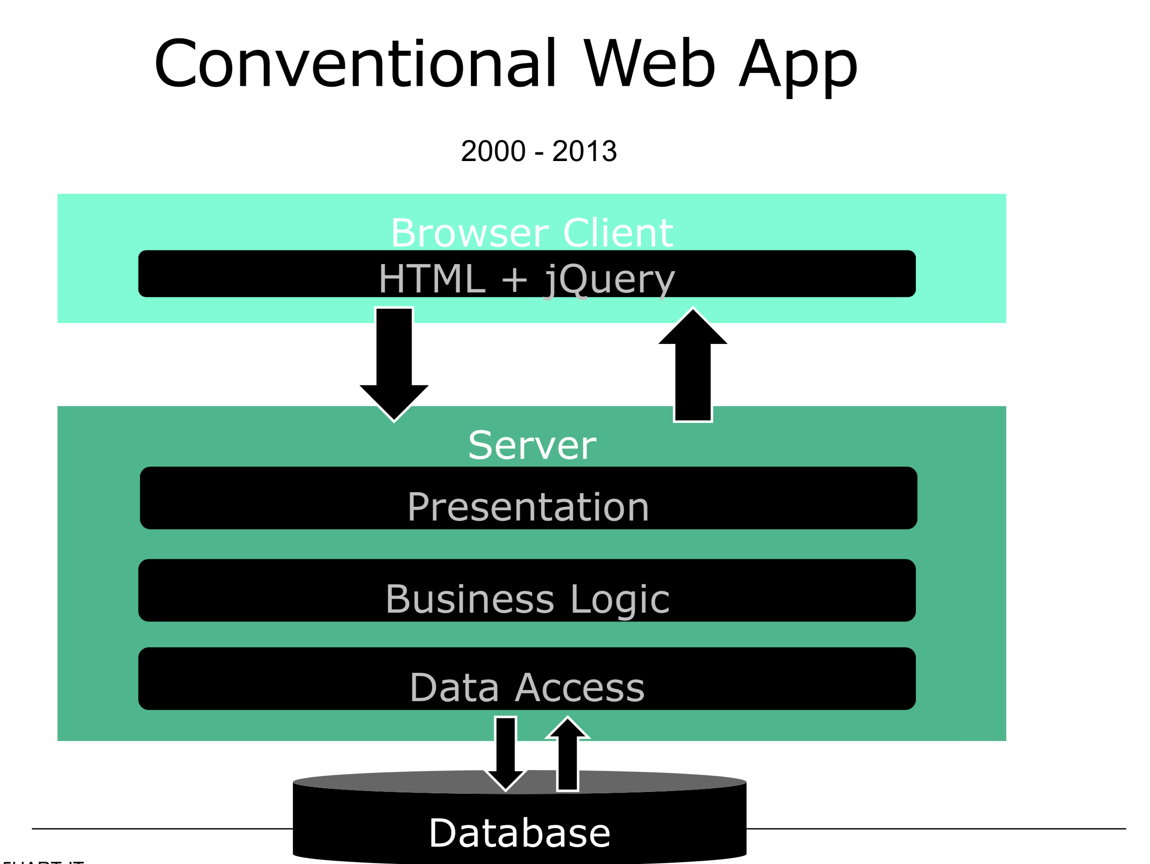

Slide 10
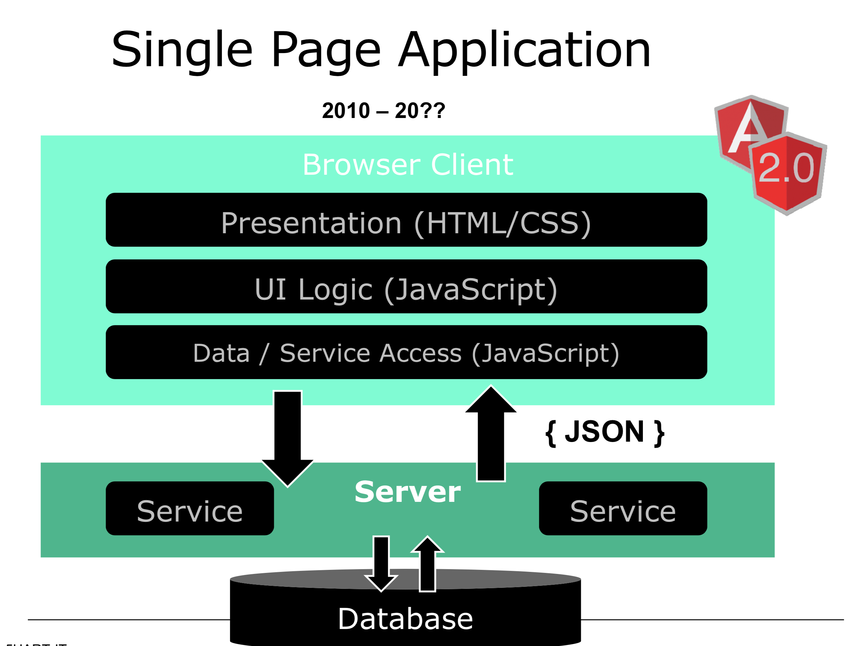

Slide 12




Slide 13
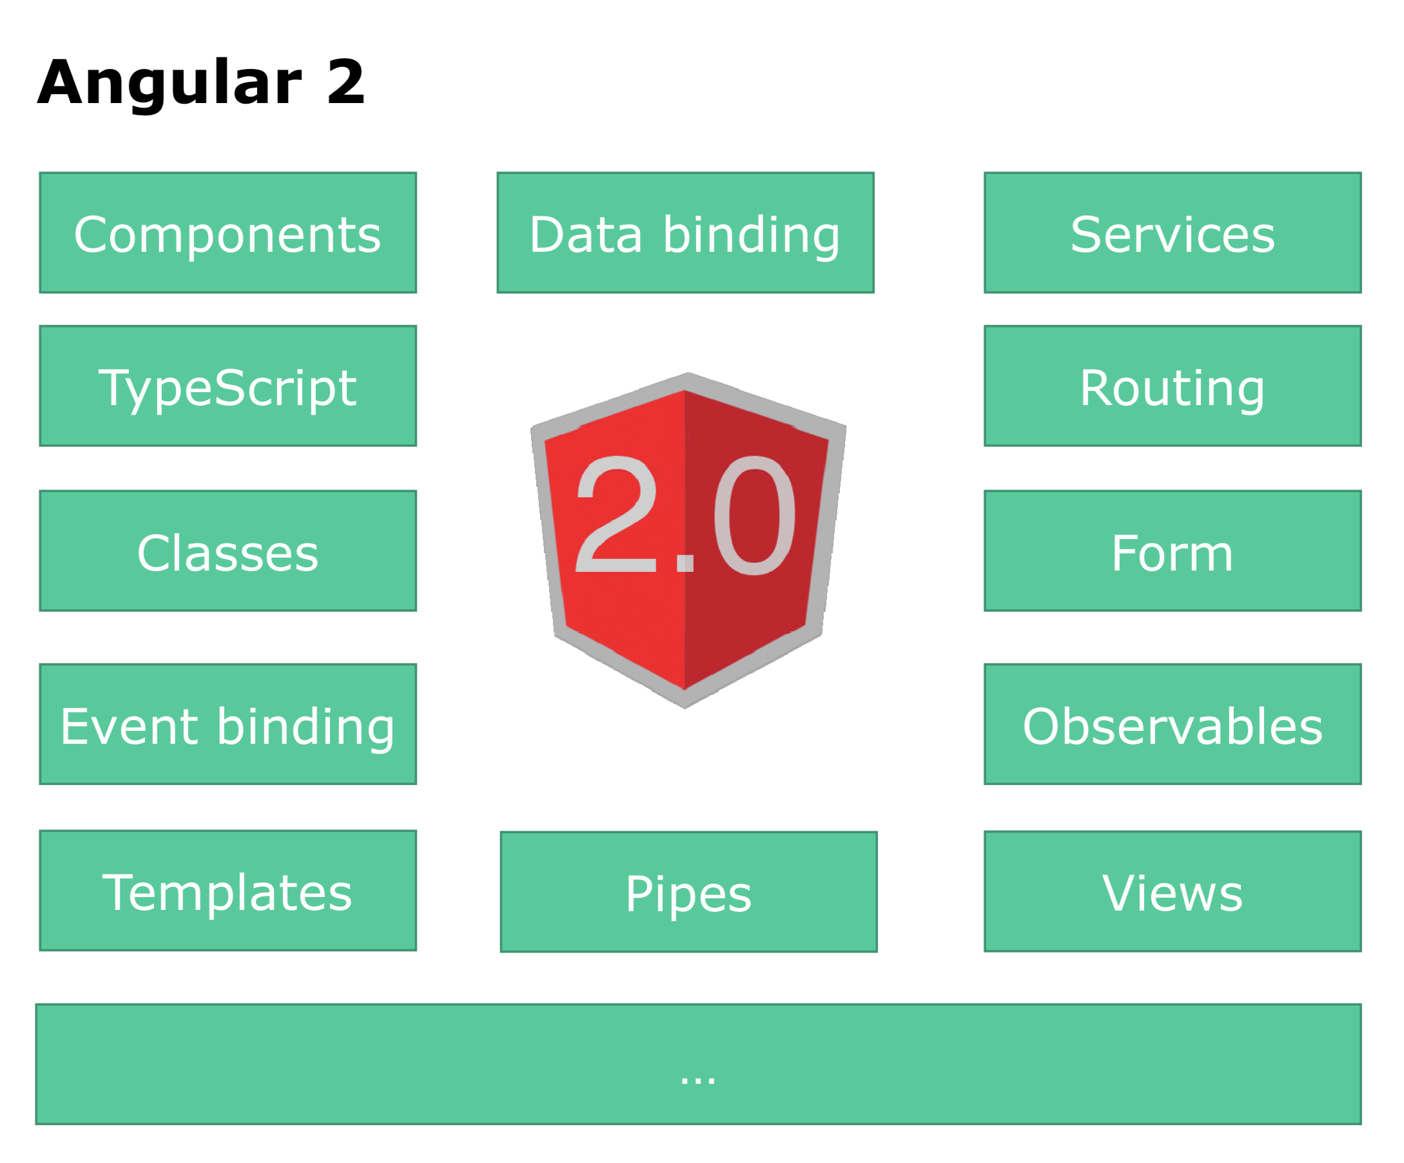

Slide 14
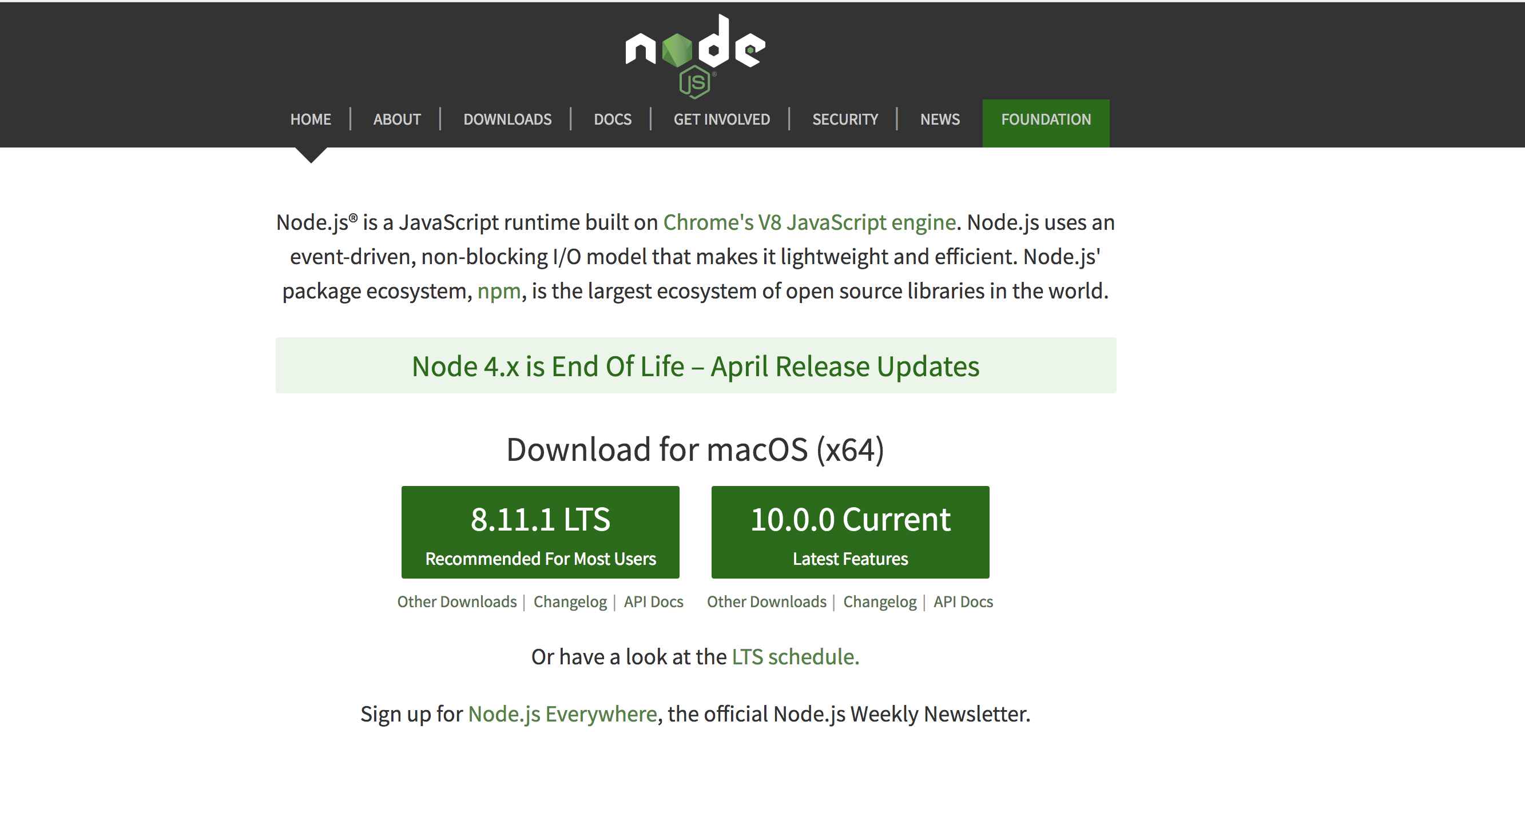
Install Node

Slide 15
IDE

Slide 16
Angular
TypeScript
Component based
DI
Efficient development
Notes:
TypeScript en Angular 2 gaan hand in hand. TypeScript is een typed superset van JavaScript
Component based → Is herbruikbare logica die je toevoegt aan je html-pagina.
Performance beter! → Betere/efficientere structuur: Angular 2 Apps zijn opgebouwd volgens een boomstructuur.
Geen $Scope → Geen gezamenlijk gebruik van de Scope. Componenten zijn niet meer gekoppeld aan elkaar middels $Scope.
DI – Wordt gebruik gemaakt van interfaces (niet van concrete implementaties)
IDE → refactoring + autocompletion + type error op compilatie en runtime nivo
http://www.technofattie.com/2014/03/21/five-guidelines-for-avoiding-scope-soup-in-angular.html
http://busypeoples.github.io/post/thinking-in-components-angular-js/
- Gezamenlijk gebruik van $scope door meerdere controllers → controller kunnen niet afzonderlijk getest worden.
Problemen met scope in controller:
Niet makkelijk te testen
Controller is gekoppeld aan $scope
Controller niet herbruikbaar
Controller moeilijk te onderhouden
Gezamenlijk gebruik van $scope door meerdere controllers
- Scope kan je niet migreren

Slide 17
TypeScript

Slide 18
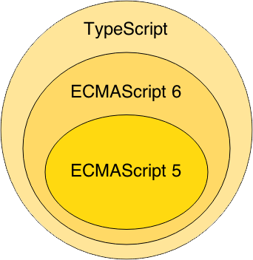
TypeScript
Notes:
Waarom TypeScript?
TypeScript is superset of ES6 en ES5.
ES = Standaard specificatie van JavaScript
ES6 = de nieuwste specificatie van Javascript, maar wordt nog niet ondersteund in alle browsers.
ES5 is de huidige standaard voor javascript en wordt ondersteund in de browsers.
TypeScript wordt vertaald naar ES5 (Middels een Transpiler).
TypeScript = Annotaties + Types + Interfaces + ES6
-----------------
TypeScript is van Microsoft.
Javascript is geschreven conform ES5

Slide 19


TypeScript = Annotaties + Types + Interfaces + ES6

Slide 20
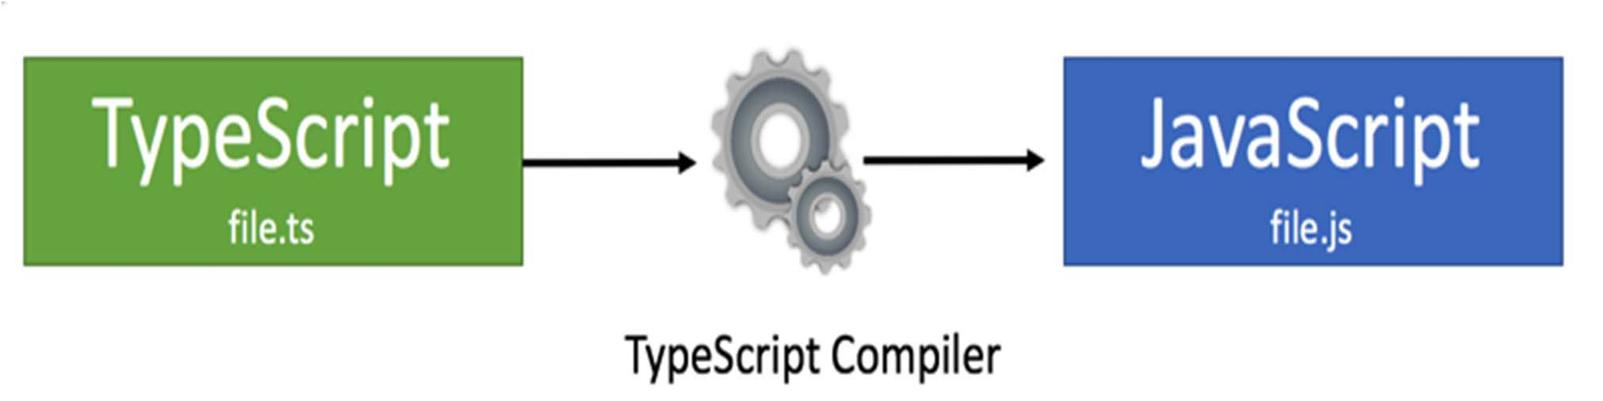
TypeScript Compilation
Zowel TypeScript als ES 6: compilatie nodig,
Huidige generatie browsers begrijpt ES6 en TypeScript niet.

Slide 21
TypeScript Class
class BookListComponent extends BaseComponent {
books: String[];
constructor() {
this.books =[‘book1’, ‘book2’]
}
}
Notes:
Example of a TypeScript class !!!
This refers to the class.

Slide 22
Components

Slide 23
Bootstrap flow Creates the component(s) and inserts each one into the browser DOM
main.ts
AppModule
AppComponent
app.component.html
BookSearchComponent
BookListComponent
BookDetalsComponent
Notes:
Bootstrap flow
You launch the application by bootstrapping the root AppModule. Among other things, the bootstrapping process creates the component(s) listed in the bootstrap array and inserts each one into the browser DOM.
https://v2.angular.io/docs/ts/latest/guide/appmodule.html

Slide 24
A component adds logic to DOM elements

Slide 25
Flow Angular app consist of a treestructuur of components
index.html
AppComponent
app.component.html
BookSearchComponent
BooksListComponent
BookDetalsComponent
Notes:
Angular is a tree of components, because it has the same structure as your html-structure !!!
Index.html is the parent template of AppComponent ect…
AppComponent is the parent of BookComponent and …
main.ts

Slide 26
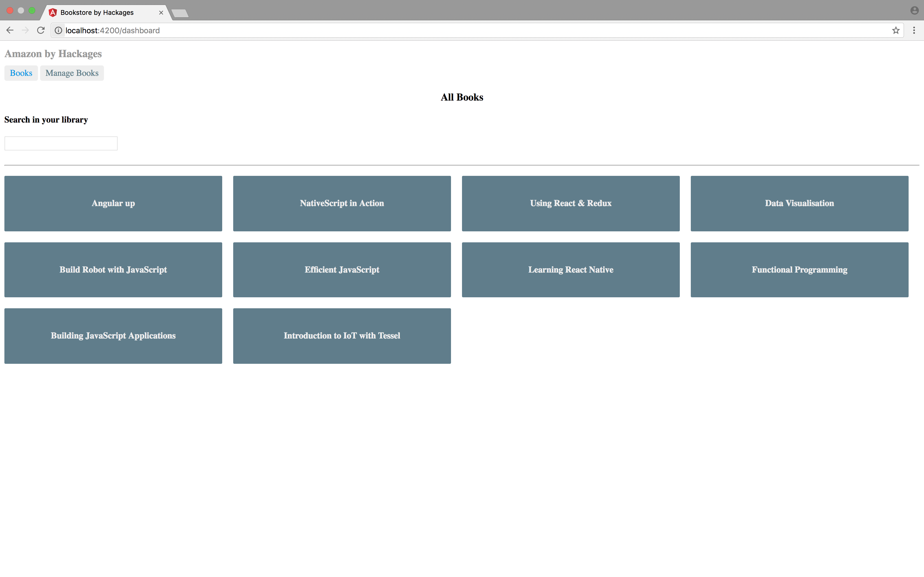

Slide 27
Component based
SideBarComponent
AppModule
Module
AppComponent
BookSearchComponent
BookListComponent
Notes:
Angular apps are composed of modules.
Modules exports classes, function, values — that other modules import.

Slide 28
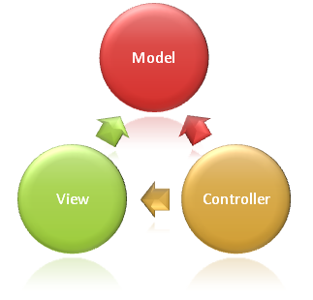
Syntax Component
import {Component} from ’@angular/core';
@Component({
selector: ‘book-list'
templateUrl: ‘booklist.template.html'
})
export class BookListComponent {
books: string[];
constructor() {
this.books =[‘book1’, ‘book2’]
}
}
Notes:
Structuur
This class is written in Typescript!
How to convert this class in a Component:
- You import the Typescript libraries from Angular ---> a Component is imported here
- You can now convert the class in a Component with the @Component annotation
- templateUrl - the address of this component's template
How does this work in action
With the selector you can instantiate and call the component
With the CSS selector you can tell Angular to create an instance of this component where it finds a <grocery-list> tag in parent HTML.
You export the Component class so that you can import and use it in the rest of your application.

Slide 29
Selector in index.html
….
<book-list></book-list>
….

Slide 30
Syntax template booklist.template.html
<p>Booklist: </p>
<ul>
<li *ngFor = “let book of books">
{{book}}
</li>
</ul>
Notes:
https://angular.io/docs/ts/latest/guide/template-syntax.html#!#star-template
*ng-for – Why?
The STAR Turns the li element and its contents into a template, and uses that template to instantiate a view for each item in list.

Slide 31
Module
SideBarComponent
AppModule
Module
AppComponent
BookSearchComponent
BookListComponent
Notes:
Angular apps are composed of modules.
Modules exports classes, function, values — that other modules import.

Slide 32
AppModule
import {NgModule} from ‘@angular/core';
import {BrowserModule} from ‘@angular/platform-browser';
import {AppComponent} from ‘./app.component';
import {BookSearchComponent} from ‘../book-search/book-search.component';
import {BookListComponent} from ‘../book-list//book-list.component';
@NgModule({
imports: [BrowserModule], // inject build-in modules
declarations: [AppComponent , BookSearchComponent, BookListComponent], // inject your own components
bootstrap: [AppComponent] // main component you need to bootstrap
})
export class AppModule { }
Notes:
AppModule is the main entrypoint of your application = root module
@NgModule: Use @NgModule to Manage Dependencies in your Angular 2 Apps
Since we declared the BookListComponent in our root module, we can now use this BookListComponent anywhere in our application without needing to declare or import it again. In essence, the @NgModule handles dependency injection for us, so any component we declare will have the inherent knowledge of our other dependencies. We are not limited to declaring only components here, we could additionally write a directive or service, and declare use it the exact same way.
Imports: for importing build-in modules example BrowserModule for using: *ng-for
Declarations: for injecting your own components
Bootstrap: you need to bootstrap your main component
An‘umbrella’component(akaModule),holding all the dependencies that the Injector needs
• TypeScript annotation:@ngModule({...})
Inject other components
Inject Services/Providers
Bootstrap the Rootcomponent

Slide 33
Angular CLI
Create projects via the Command line

Slide 34
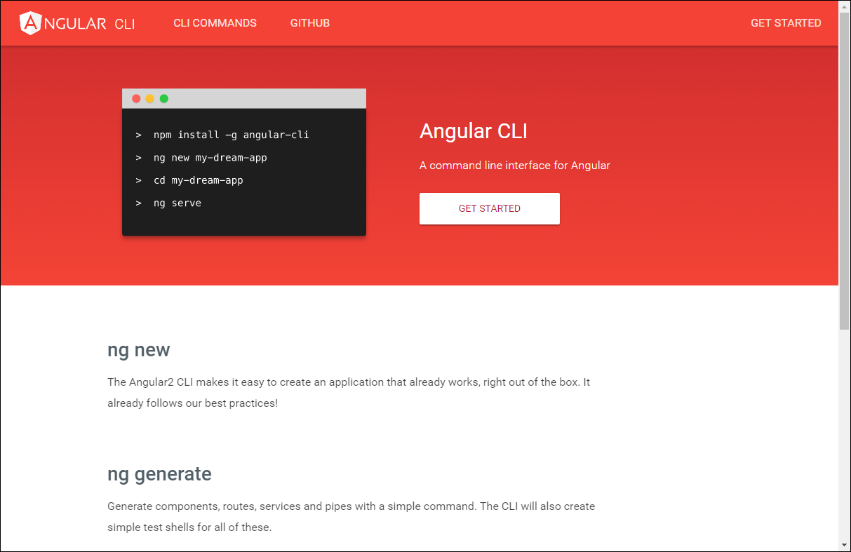

Slide 35
Install/Upgrade Angular CLI to 7
Install the Angular CLI
[sudo] npm install -g @angular/cli@latest
Notes:
If your version is still old, then try the following command:
-> ng update @angular/cli
check:
ng --version

Slide 36
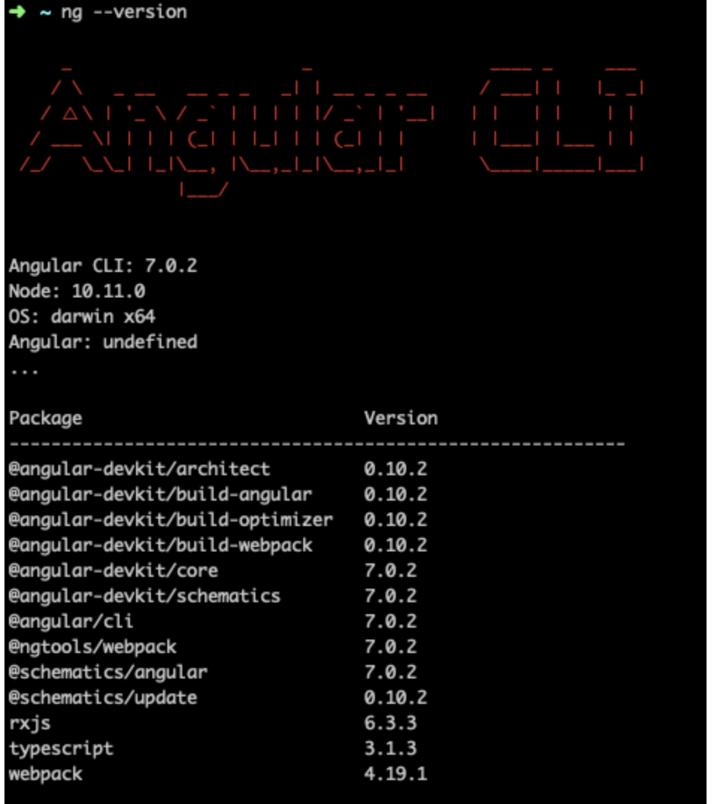
Check your Angular CLI version

Slide 37
Update Angular Packages
ng update @angular/core
ng update rxjs

Slide 38
Scaffolding - Angular CLI
Notes:
Projecten, componenten, routes en meer definiëren vanaf de command line (CLI)

Slide 39
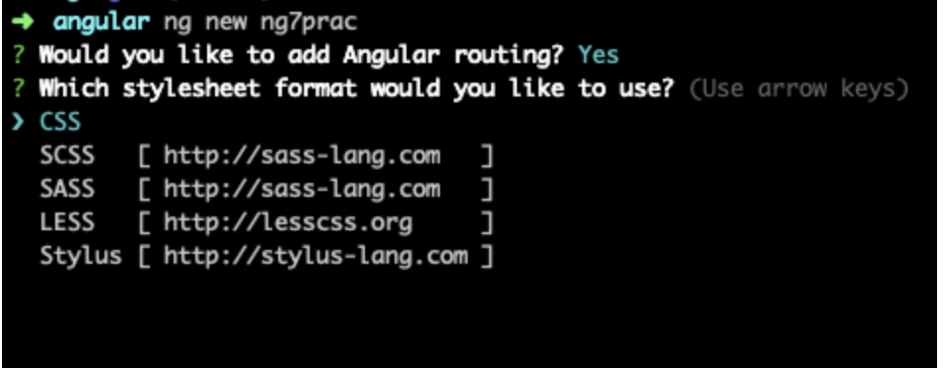
Generating an Angular project
ng new my-project
Notes:
The ng new command creates an Angular workspace folder and generates a new app skeleton.

Slide 40
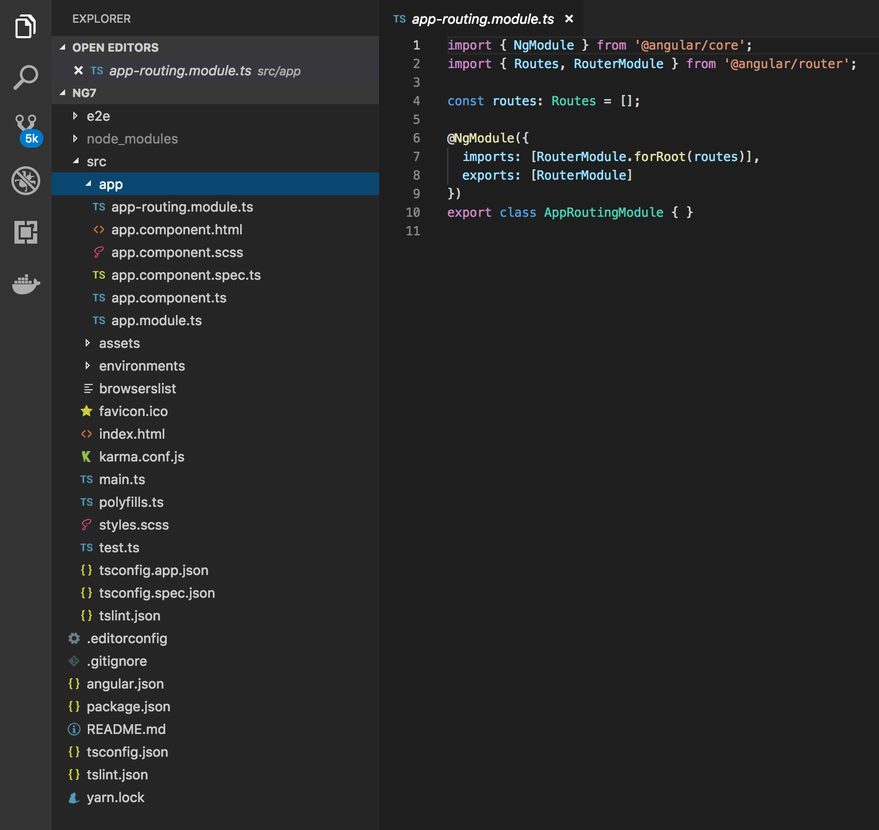
Notes:
A newly generated app contains the source files for a root module, with a root component and template. Each app has a src folder that contains the logic, data, and assets.

Slide 41
Generating and serving an Angular project
ng new my-project
cd my-project
ng serve
In your browser, open http://localhost:4200/
Notes:
The ng new command creates an Angular workspace folder and generates a new app skeleton.
ng serve → When you use the ng serve command to build an app and serve it locally, the server automatically rebuilds the app and reloads the page when you change any of the source files.

Slide 42
ng generate <component>

Slide 43
ng generate
Use the ng generate command to:
ng generate <components>
ng generate <services>
Notes:
https://scotch.io/tutorials/use-the-angular-cli-for-faster-angular-2-projects

Slide 44
Angular - Routing

Slide 45
Routing architecture and goal
index.html
Home
BookList
/book-list
/
/add
About
/about
BookAdd

Slide 46
Routing – every route is a Component
Components are injected in: <router-outlet></router-outlet>
HomeComponent
<router-outlet></router-outlet>
About
BookList Component
BookAdd Component
… Component
Component

Slide 47
Stappenplan routing

Slide 48
1. Base Href toevoegen in index.html (!)
<base href="/">

Slide 49
2. Add Routes in app.routes.ts
// app.routes.ts
import {Routes} from '@angular/router';
import {AppComponent} from "./app.component";
import {BookListComponent} from "./book-list.component";
import {BookAddComponent} from "./book-add.component";
export const AppRoutes: Routes = [
{path: '', component: AppComponent},
{path: 'home', component: AppComponent},
{path: ‘book-list', component: BookListComponent}
{path: 'add', component: BookAddComponent}
];

Slide 50
3. Define Routes in app.Module.js
Import RouterModule in applicatie
Import ./app.routes in applicatie
…
// Router
import {RouterModule} from '@angular/router'; import {AppRoutes} from './app.routes';
Import Router- onderdelen
Nieuw!
MainComponent gaan we nog maken
// Components
import {MainComponent}
…
@NgModule({ imports : [
from './MainComponent';
BrowserModule, HttpModule, RouterModule.forRoot(AppRoutes)
Configure RouterModule.forRoot()
],
declarations: [ MainComponent, BookListComponent, BookAddComponent
],
bootstrap : [MainComponent]
})
export class AppModule {
MainComponent wordt nu gebootstrapt
}

Slide 51
4. Make MainComponent with Routing
Nieuwe component voor hoofdmenu en <router-outlet>
import {Component, OnInit} from '@angular/core';
<!‐‐ Add routerLink directive. Angular replaces this with correct <a href="..."> ‐‐>
<a routerLink="/book-list" class="btn btn‐primary">List of books</a>
<a routerLink="/add" class="btn btn‐primary">Add Book</a>
<!‐‐ Dynamically inject components here ‐‐>
<router‐outlet></router‐outlet>
`
@Component({
selector: 'main‐component', template: `
<h1>Pick your favorite city</h1>
“Hoofdmenu”. Let op routerLink
})
export class MainComponent implements OnInit {
<router-outlet>
}

Slide 52
5. Create new Components
Elke component is een route!
// book-add.component.ts
import { Component } from '@angular/core';
add‐city',
<h1>Add City</h1> …`
ityAddComponent{
@Component({ selector: ' template: `
})
// book-edit.component.ts
import { Component } from '@angular/core';
// book-detail.component.ts
ity',
it City</h1> …`
tComponent{
@Component({ selector: 'edit‐b template: `<h1>Ed
})
import { Component } from '@angular/core'
export class B
…
}
@Component({
selector: 'detail‐book', template: `<h1>Detail Book</h1> …`
})
export class BookEdi
…
}
export class BookDetailComponent{
…
}

